Slide 1
Introduction to Machine Learning
DENSYS school
June 2021
Selim El Mekki, Bertrand Cornélusse

Slide 2
Outline
Introduction
Types of machine learning problems
Supervised learning
Simple models, overfitting & underfitting, Cross validation
k-NN
Decision tree
Steps to solve a SL problem
Practice session: room occupancy prediction

Slide 3
For more info
Short intro in my PhD thesis: https://orbi.uliege.be/handle/2268/82167
An introductory course: https://people.montefiore.uliege.be/lwh/AIA/

Slide 4
What is Machine Learning
Machine learning is the study of computer algorithms that improve automatically through experience and by the use of data.
Common applications:
Image recognition
Email Spam & Malware filtering
Speech recognition
Social media customized advertising
Netflix’s recommandations
Medical diagnosis

Slide 5
Why Machine Leaning now?
More Data
Faster compute engines
Algorithms (old and new)
Machine learning softwares

Slide 6
Types of machine learning
Supervised learning
Unsupervised learning
Reinforcement Learning
And many variants …

Slide 7
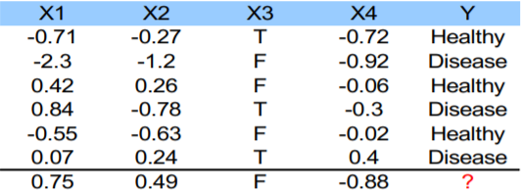
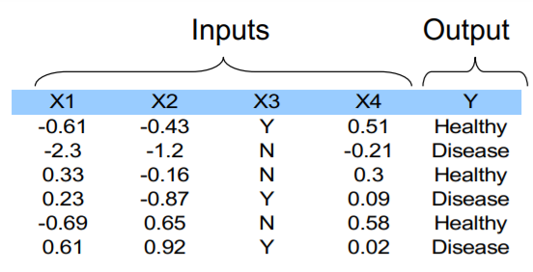
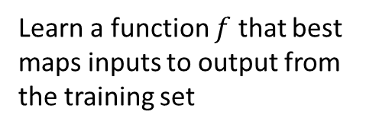
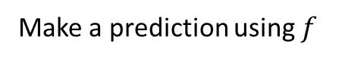
Supervised Learning
Goal: from the dataset, find a function f of the inputs that approximates at best the output
Learn a function $f$ that best maps inputs to output from the training set
Make a prediction using $f$
training set

Slide 8
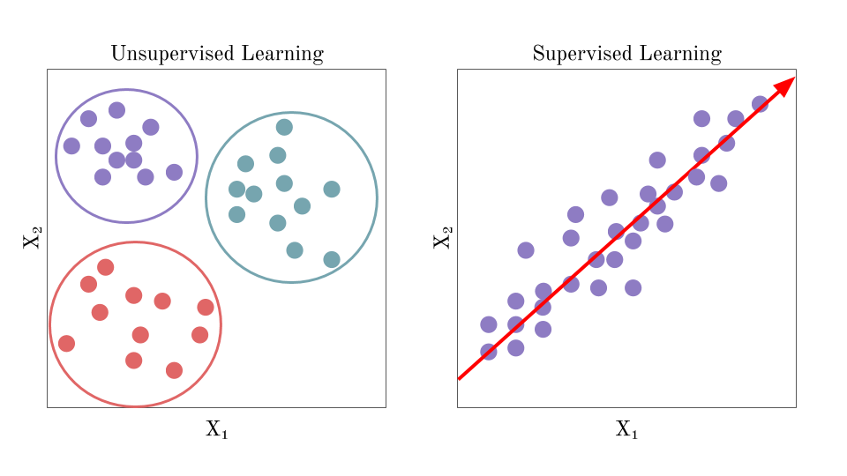
Unsupervised Learning
Unsupervised learning does not use labeled data.
Instead of making predictions, the goal of unsupervised learning is to find the underlying structure of dataset and group that data according to similarities.

Slide 9
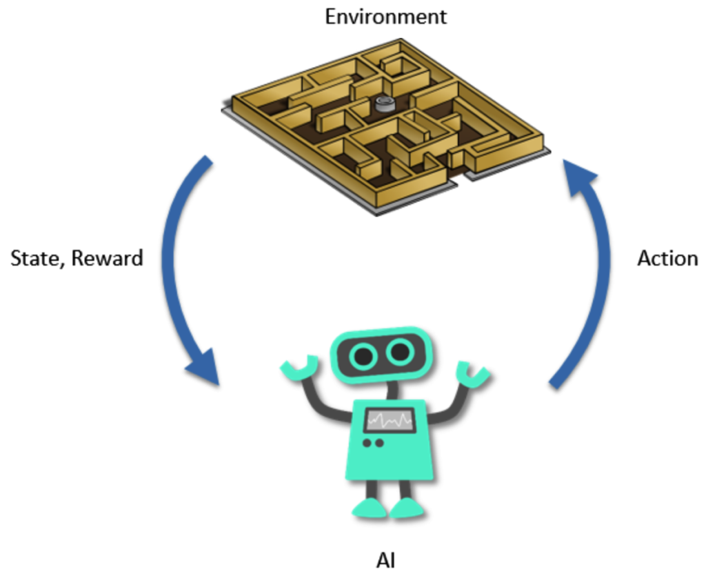
Reinforcement Learning
Learning from interactions with an environment
Goal: learn to take the actions in any given state in order to maximize a reward function by interacting with an environment
Example:
State: the robot position in the labyrinth
Actions: Go ahead, turn right, turn left
Reward: Get a reward each time the robot
manages to get out of the labyrinth
Goal: learn from experience how to get
out of the labyrinth as fast as possible (i.e. find the optimal action to pick for any given state)

Slide 10
Supervised Learning

Slide 11
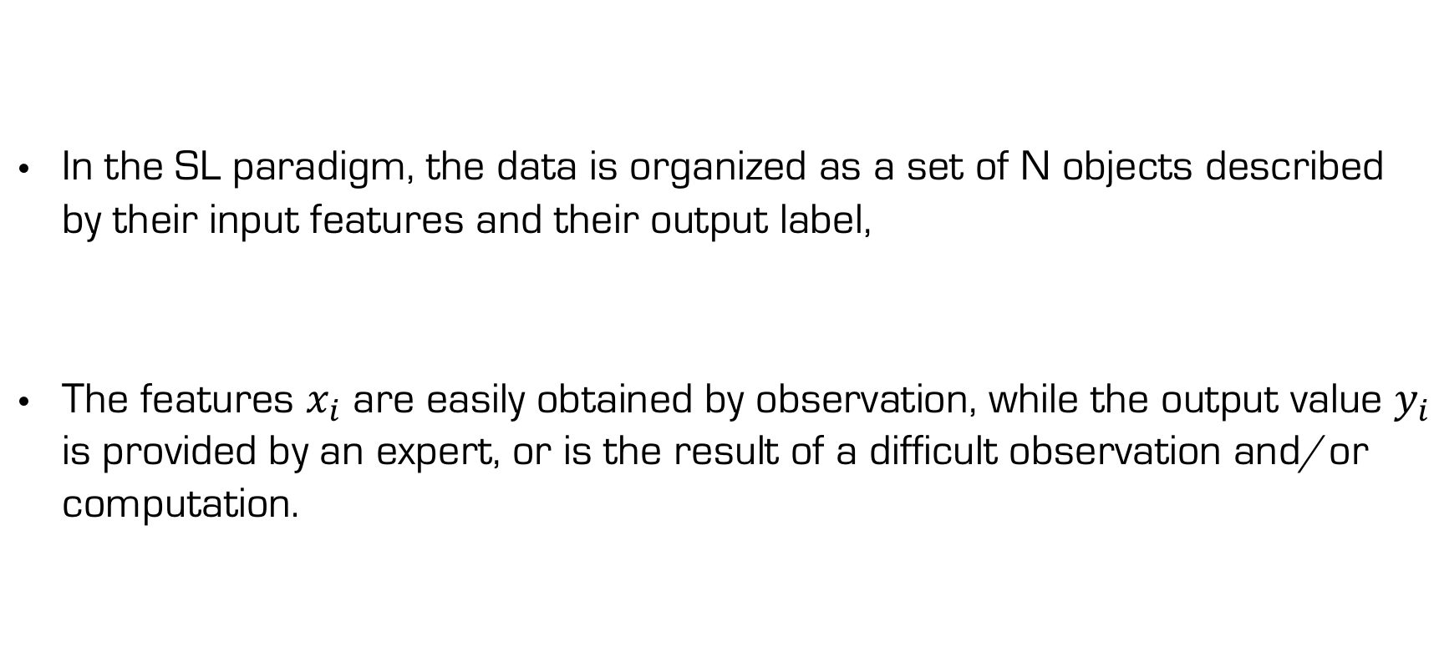
Supervised learning (SL)
In the SL paradigm, the data is organized as a set of N objects described by their input features and their output label,
The features $x_{i}$are easily obtained by observation, while the output value $y_{i}$ is provided by an expert, or is the result of a difficult observation and/or computation.

Slide 12
Mapping, loss function, expected loss
SL algorithms search for a mapping between the feature space and the output space that generalizes well to elements for which the output value has not been observed.
To this end, we define a loss function
and search for a mapping h which minimizes the expected loss

Slide 13
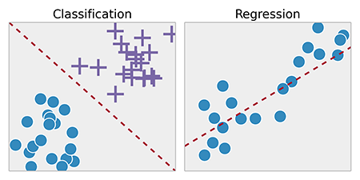
Classification and Regression
Classification is the task of approximating a mapping function (h) from input variables (X) to discrete output variables (y).
Examples: Predict if an email is a spam or not, predict if a room is occupied or not
Regression predictive modeling is the task of approximating a mapping function (h) from input variables (X) to a continuous output variable (y).
Examples: Predict the price of a house, timeseries forecasting

Slide 14
Empirical loss minimization
As we usually do not know the joint distribution of the objects, we instead search for a function that minimizes an estimate
of the expected loss, also called the empirical loss.

Slide 15
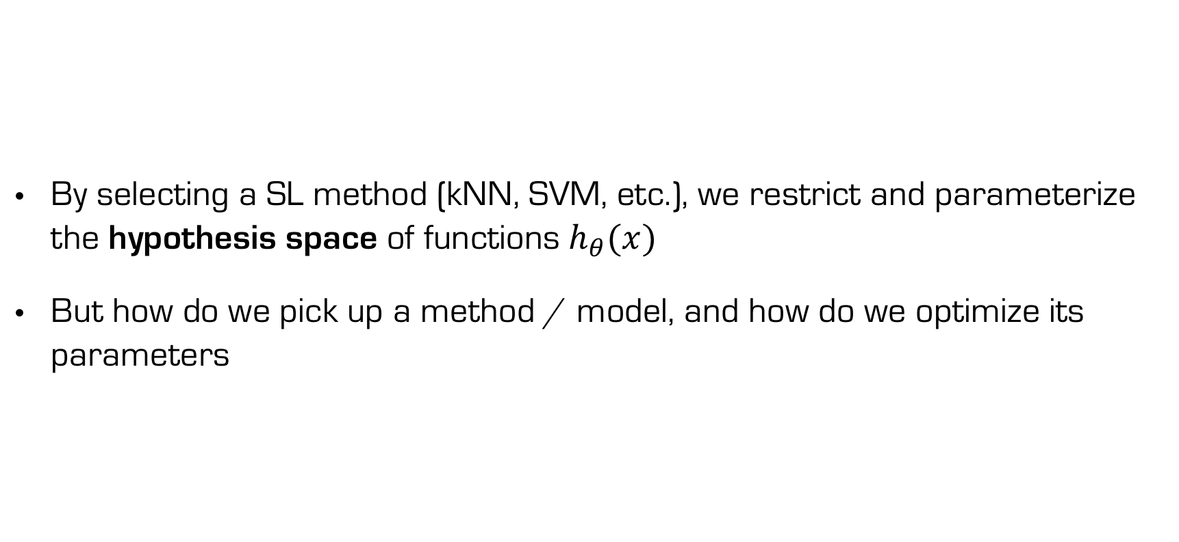
Model selection
By selecting a SL method (kNN, SVM, etc.), we restrict and parameterize the hypothesis space of functions$h_{θ}(x)$
But how do we pick up a method / model, and how do we optimize its parameters

Slide 16
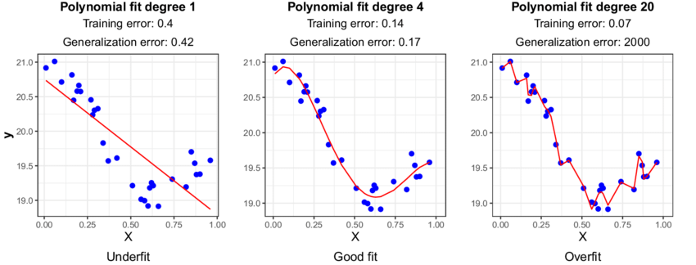
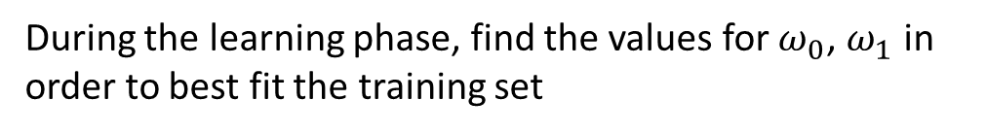

Linear model
Polynomial of degree 1 regression model with 1 input and 1 output
$$h\left(X\right)=ω_{0}+ω_{1} X$$
During the learning phase, find the values for $ω_{0}$, $ω_{1}$ in order to best fit the training set

Slide 17
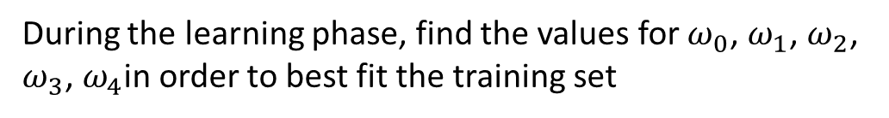
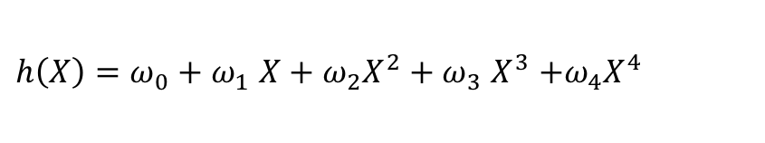
4th degree polynomial
Polynomial of degree 4 regression model with 1 input and 1 output
$h\left(X\right)=ω_{0}+ω_{1} X+ω_{2}X^{2}+ω_{3}$ $X^{3}$ $+ω_{4}X^{4}$
During the learning phase, find the values for $ω_{0}$, $ω_{1}$, $ω_{2}$, $ω_{3}$, $ω_{4}$in order to best fit the training set

Slide 18
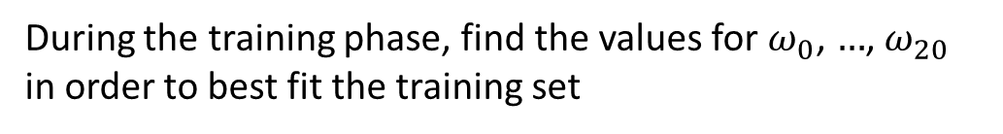
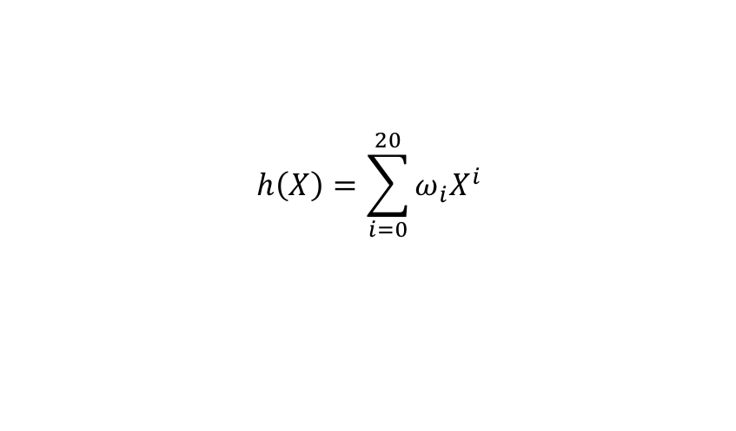
20th degree polynomial
Polynomial of degree 20 regression model with 1 input and 1 output
$$h\left(X\right)=\sum_{i=0}^{20}{ω_{i}X^{i}}$$
During the training phase, find the values for $ω_{0}$, $…$, $ω_{20}$ in order to best fit the training set

Slide 19
Model selection
Linear model error on the training set: 0.4
4th degree polynomial error on the training set: 0.14
20th degree polynomial model error on the training set: 0.07
You need to evaluate your model on unseen data Test set

Slide 20
Model selection
Linear model accuracy on the test set: 0.42
4th Degree polynomial accuracy on the test set: 0.17
20th Degree polynomial accuracy on the test set: 2000
Linear model is underfitting while 20th degree polynomial is overfitting, the best fit for this problem is the 4th degree polynomial

Slide 21
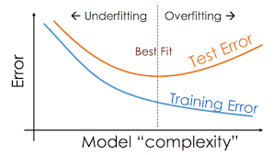
Overfitting and underfitting
We can consider that data is composed of :
A main signal
A noise signal
Overfitting happens when the model captures the noise along with the main signal in data. (20th degree polynomial)
Underfitting happens when a model is unable to capture the main signal in data. (Linear model)

Slide 22
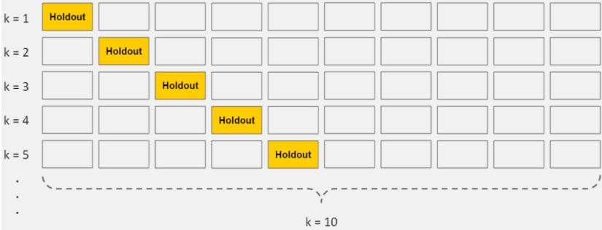
Cross-validation
In general, this is bad practice to adjust your model based on your test set performance. Cross-validation is solution to prevent overfitting without evaluating its model on the test set.
Split your initial training data into k subsets.
Iteratively train the algorithm on k-1 subsets while using the remaining fold as the “test” set (called validation set) to calculate the prediction error.
Report the mean error over the k subsets.
Cross-validation allows you to tune hyperparameters with only your original training set. This allows you to keep your test set as a truly unseen dataset for selecting your final model.

Slide 23
There are many SL methods
(Linear) regression
Nearest neighbors
Regression and decision trees
Support vector machines / support vector regression
Artificial neural networks => deep learning
Ensemble methods
…
Notes:
For all you solve an optimization problem (sometimes approximately)

Slide 24
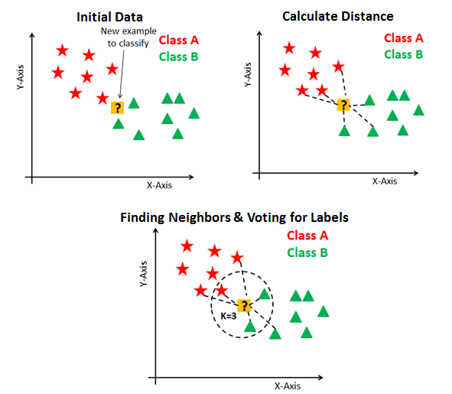
k-NN
Find the k nearest neighbors with respect to Euclidian distance
Output the most frequent class (classification) or the average outputs (regression) among the k neighbors

Slide 25
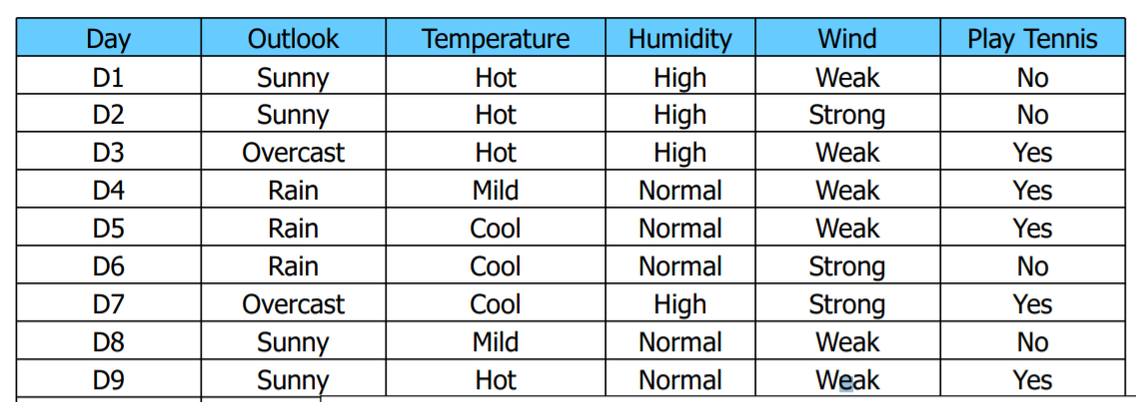
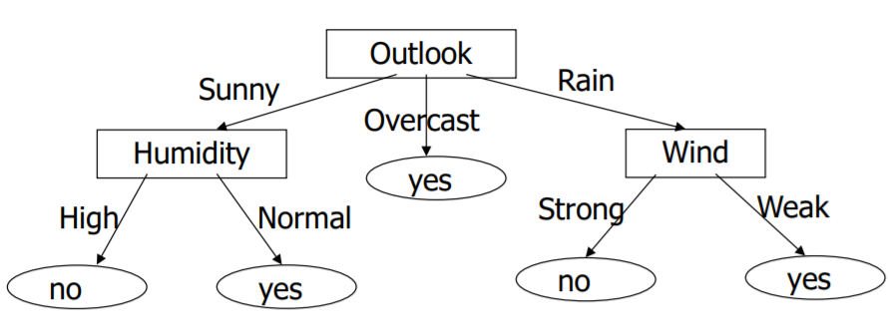
Decision Tree
Choose the input that best separate the training set
Split the training set according to the chosen input
Proceed recursively until each object is correctly classified
Notes:
Tree-based supervised learning is well known for its computational eciency, interpretability, robustness to outliers, its capability to cope with high-dimensional problems with a large number of input features, and its robustness with respect to irrelevant features and noise. The idea followed by this approach is to recursively split the training set D, thanks to tests on the value of the input features, in several subsets in order to decrease a measure of impurity about the output variable until the subsets are composed of object suciently similar in the output space.

Slide 27
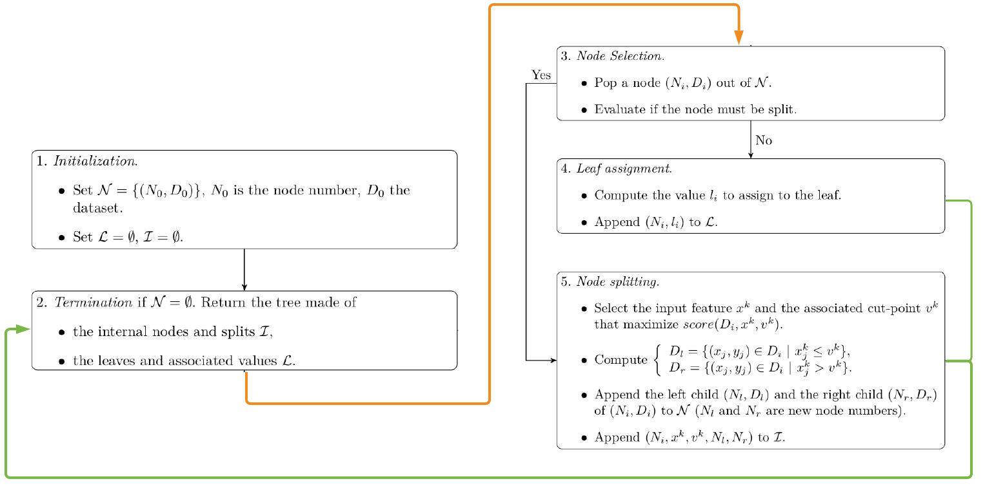
Top down induction of a regression tree (TDIRT)

Slide 28
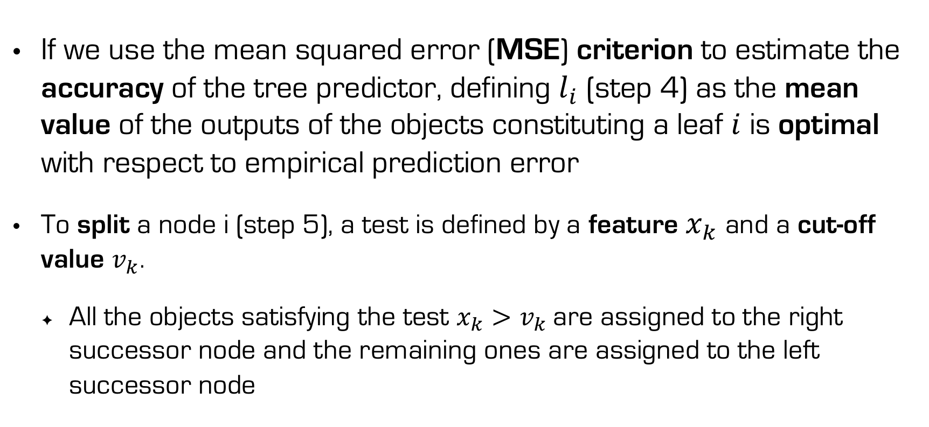
Comments
If we use the mean squared error (MSE) criterion to estimate the accuracy of the tree predictor, defining $l_{i}$ (step 4) as the mean value of the outputs of the objects constituting a leaf $i$ is optimal with respect to empirical prediction error
To split a node i (step 5), a test is defined by a feature $x_{k}$ and a cut-off value $v_{k}$.
All the objects satisfying the test $x_{k}>v_{k}$are assigned to the right successor node and the remaining ones are assigned to the left successor node

Slide 29
Splitting score
To find the best test, a score is computed for every input feature and for every possible cut-off value. For regression trees, a typical score measure is the relative decrease of output variance in the two successor nodes with respect to the output variance of the current node:
The test with the highest variance reduction is chosen

Slide 30
Until when do we split?
It is more complicated to assess if a node should be split (step 3), i.e. to mitigate the complexity of the model.
A classical way is to stop splitting when the number of objects in a node is below a threshold value,
but many other techniques have been developed to identify the tree of optimal com- plexity (pruning methods).

Slide 31
Steps to solve a supervised learning problem
Collect and clean the data
Select a suitable model
Fit your model on the training set
Evaluate it on a validation set
Adjust and improve your model (Overfitting? Underfitting?)
Evaluate your model on the test set

Slide 32
Data collection & cleaning
Quantity: the more, the better
Quality: Check if the data is well distributed
Data rescaling (faster learning)
Check missing values, wrong labeling, bad encoding
Feature engineering

Slide 33
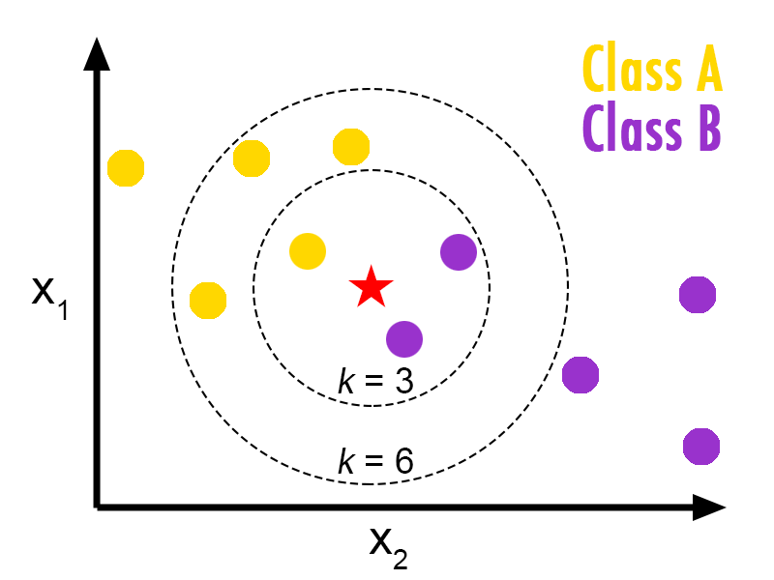
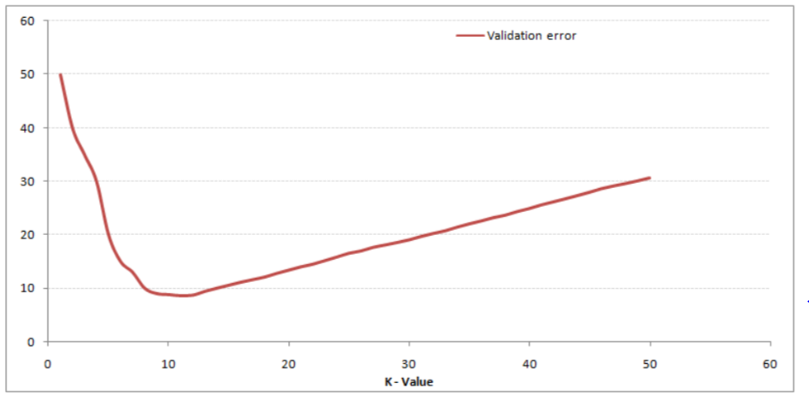
Hyperparameter tuning
Example: K-nn model
Which number of neighbors k to choose ?
Use cross validation: try several values and pick the one that generalizes the best on the validation set
Underfitting
Overfitting

Slide 34
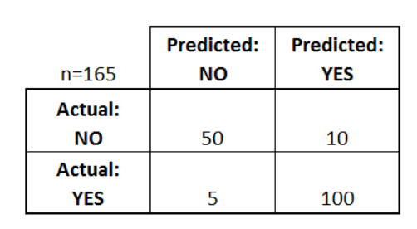
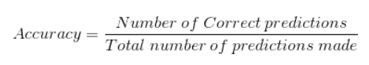
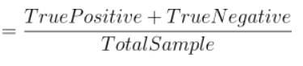
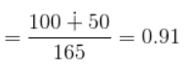
Classification metrics
Confusion Matrix
Accuracy

Slide 35
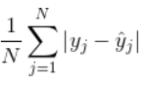
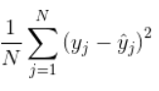
Regression metrics
Mean absolute error
Mean squared error

Slide 36
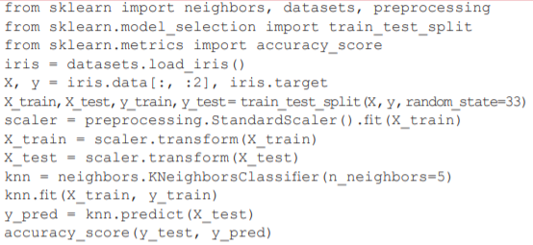
Basic example with Sklearn
Imports
Collect data and
spilt train/test
Rescale data
Model selection and training
Model evaluation on test set

Slide 37
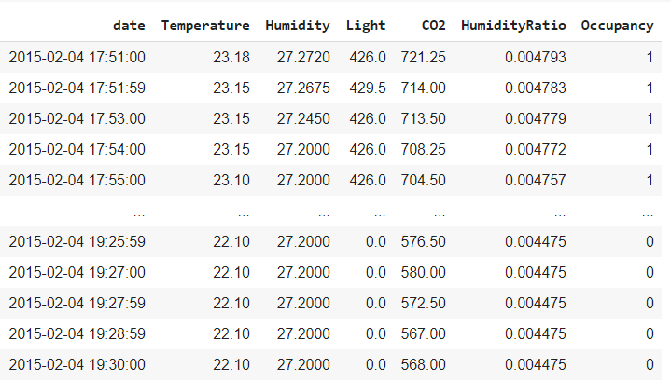
Exercise: Room occupancy prediction
Predict the occupancy of a room (1 for occupied or 0 for not occupied) based on the following inputs:
Temperature
Relative humidity
Light intensity
CO2 concentration
Humidity ratio, derived from temperature and relative humidity

